Slide 1
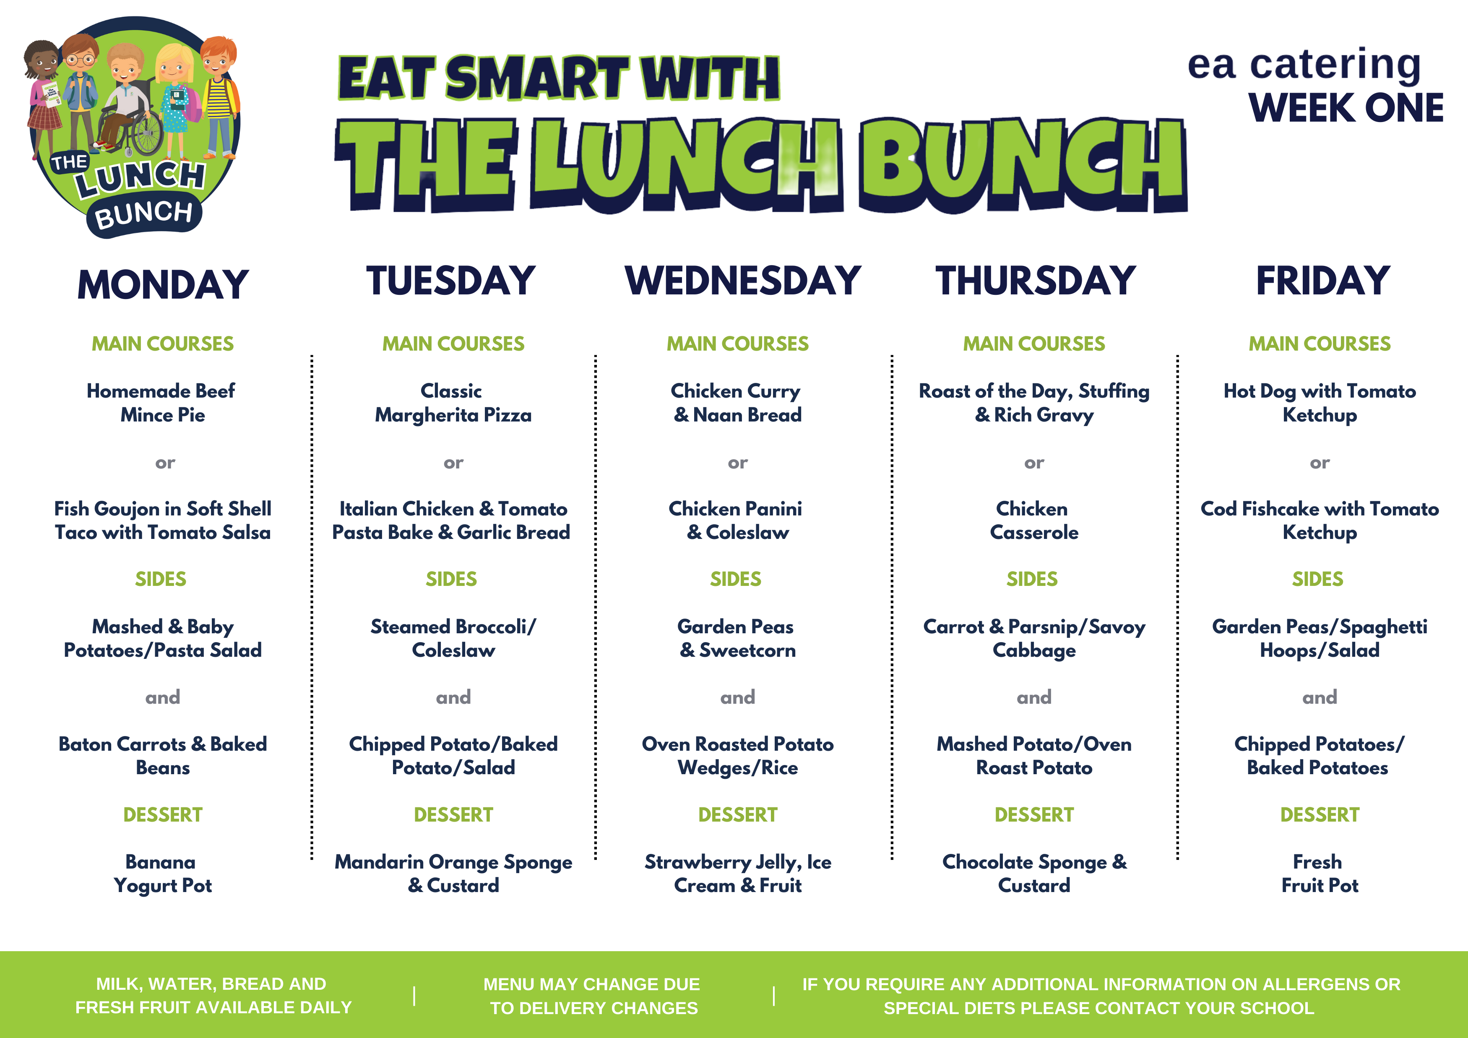
Friday 1st Sept 2023

Slide 2
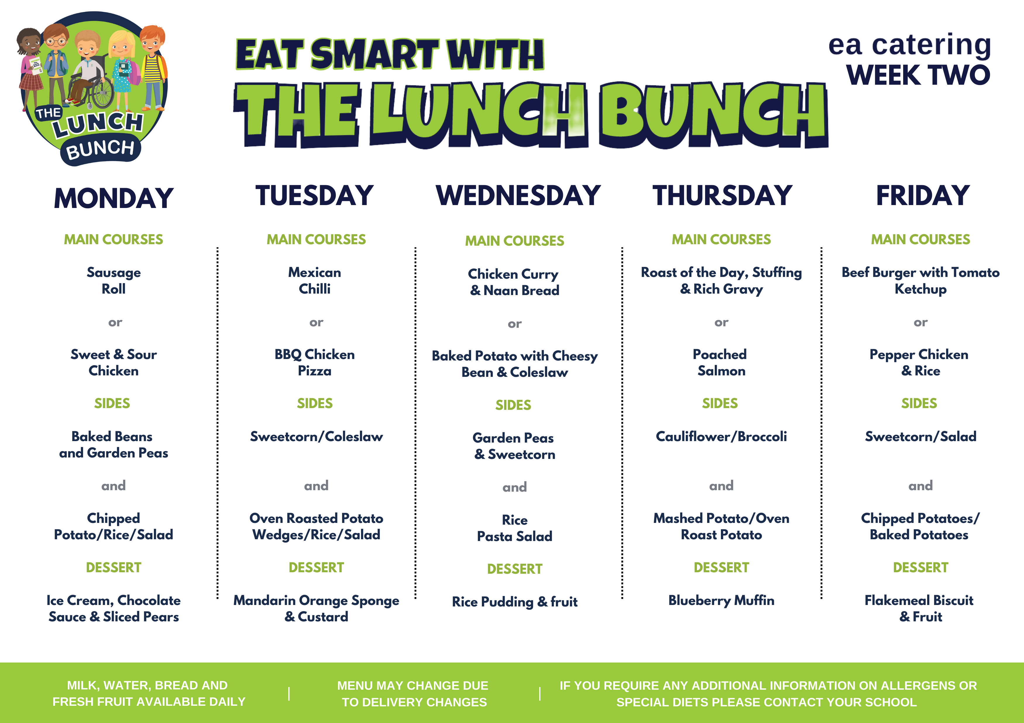
W/C 4th Sept 23

Slide 3
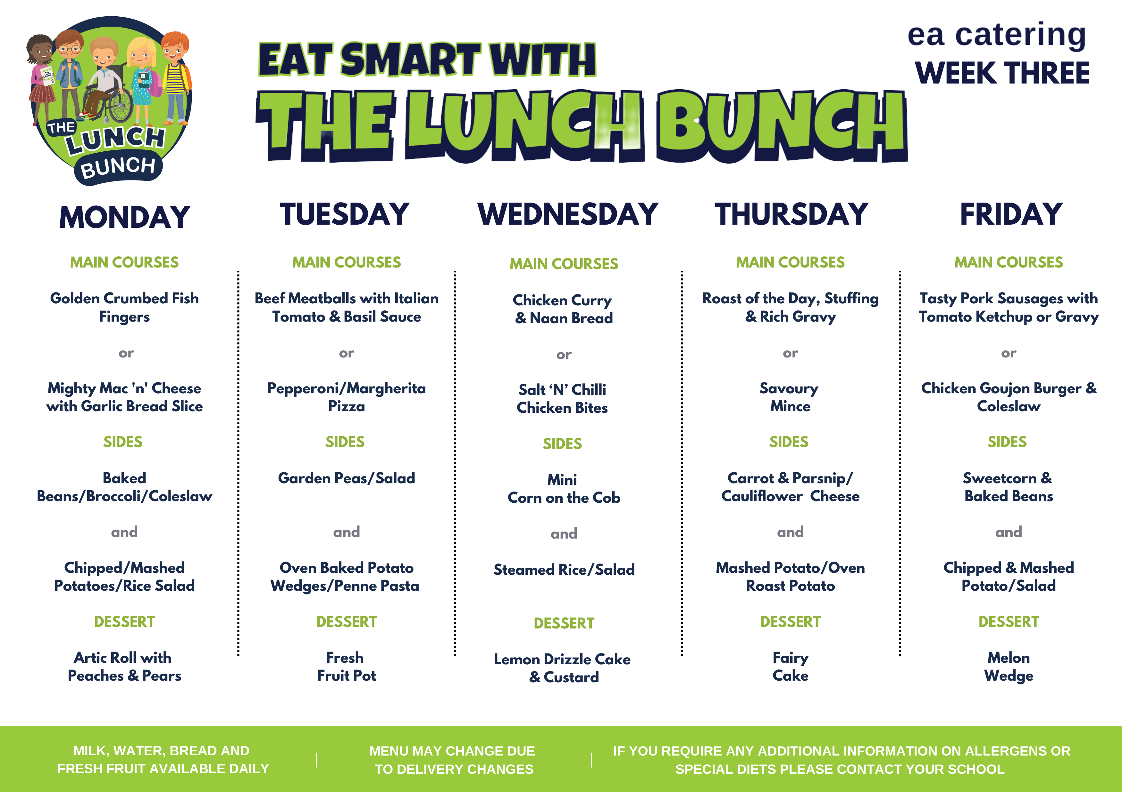
W/C 11th Sept 23

Slide 4
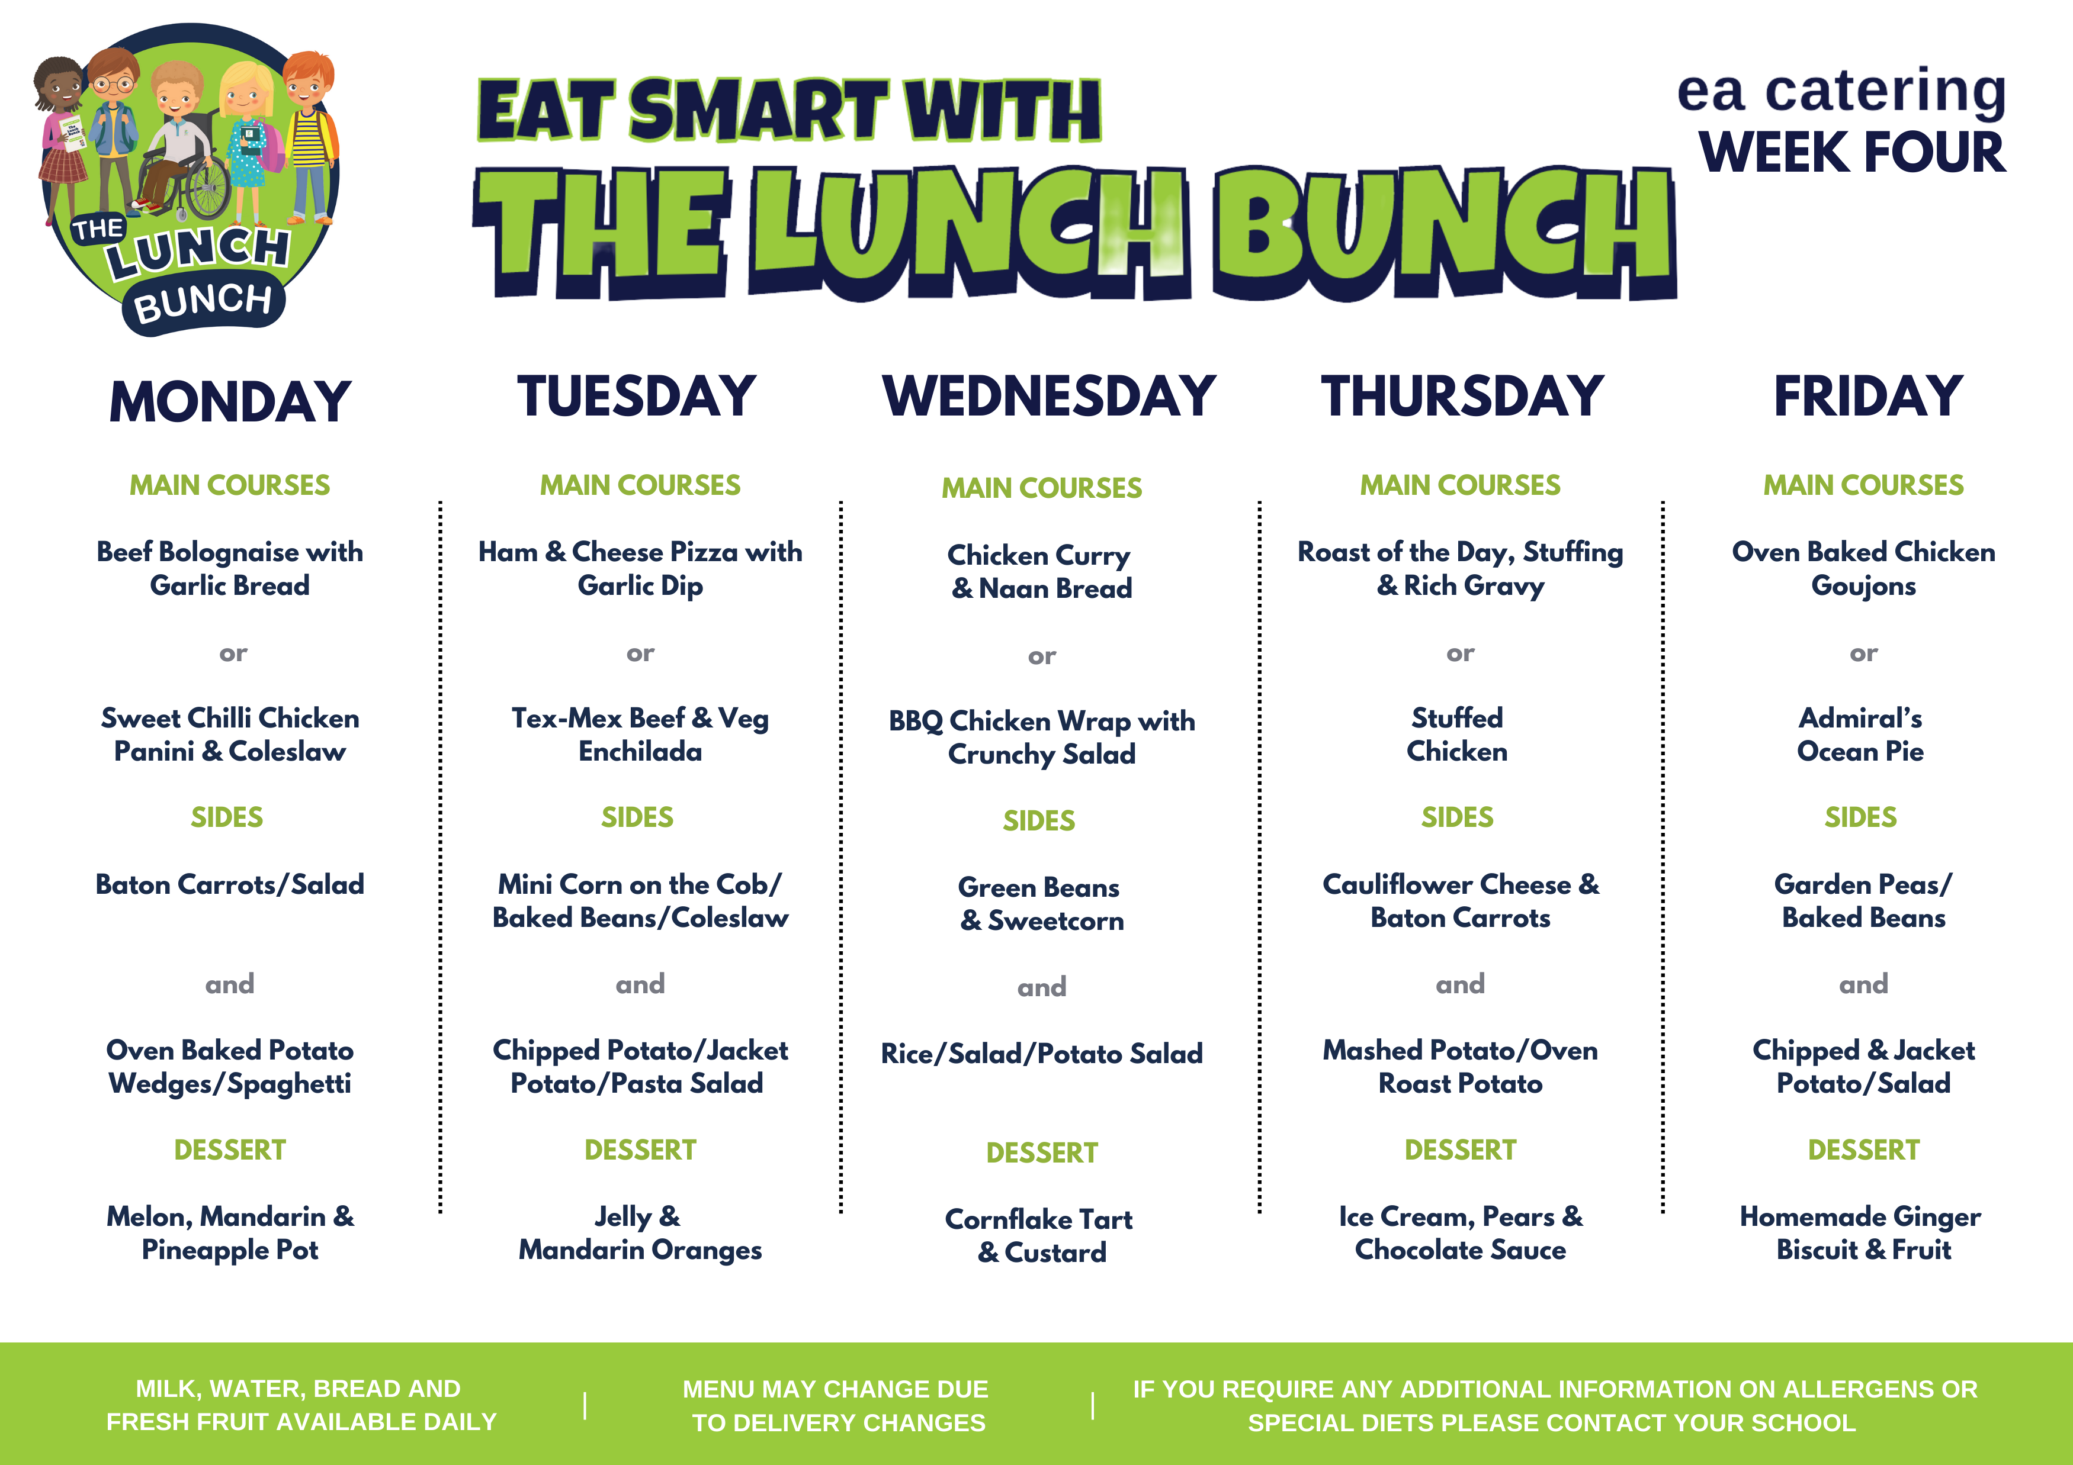
W/C 18th Sept 23

Slide 5
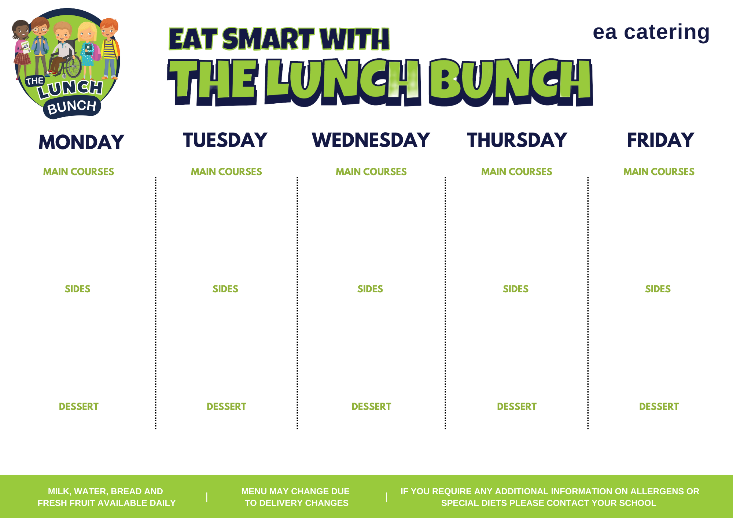
Week xxx
Week Commencing:
XXxx xx
Xxxxxxxxxxxxxxxxxxx
Xxxxxxxxxxxxxxxxxxx
Or
Xxxxxxxxxxxxxxxxxxx
xxxxxxxxxxxxxxxxxxx
Xxxxxxxxxxxxxxxxxxx
Xxxxxxxxxxxxxxxxxxx
Or
Xxxxxxxxxxxxxxxxxxx
xxxxxxxxxxxxxxxxxxx
Xxxxxxxxxxxxxxxxxxx
Xxxxxxxxxxxxxxxxxxx
Or
Xxxxxxxxxxxxxxxxxxx
xxxxxxxxxxxxxxxxxxx
Xxxxxxxxxxxxxxxxxxx
Xxxxxxxxxxxxxxxxxxx
Or
Xxxxxxxxxxxxxxxxxxx
xxxxxxxxxxxxxxxxxxx
Xxxxxxxxxxxxxxxxxxx
Xxxxxxxxxxxxxxxxxxx
Or
Xxxxxxxxxxxxxxxxxxx
xxxxxxxxxxxxxxxxxxx
Xxxxxxxxxxxxxxxxxxx
Xxxxxxxxxxxxxxxxxxx
and
Xxxxxxxxxxxxxxxxxxx
xxxxxxxxxxxxxxxxxxx
Xxxxxxxxxxxxxxxxxxx
Xxxxxxxxxxxxxxxxxxx
and
Xxxxxxxxxxxxxxxxxxx
xxxxxxxxxxxxxxxxxxx
Xxxxxxxxxxxxxxxxxxx
Xxxxxxxxxxxxxxxxxxx
and
Xxxxxxxxxxxxxxxxxxx
xxxxxxxxxxxxxxxxxxx
Xxxxxxxxxxxxxxxxxxx
Xxxxxxxxxxxxxxxxxxx
and
Xxxxxxxxxxxxxxxxxxx
xxxxxxxxxxxxxxxxxxx
Xxxxxxxxxxxxxxxxxxx
Xxxxxxxxxxxxxxxxxxx
and
Xxxxxxxxxxxxxxxxxxx
xxxxxxxxxxxxxxxxxxx
Xxxxxxxxxxxxxxxxxxx
Xxxxxxxxxxxxxxxxxxx
Xxxxxxxxxxxxxxxxxxx
Xxxxxxxxxxxxxxxxxxx
Xxxxxxxxxxxxxxxxxxx
Xxxxxxxxxxxxxxxxxxx
Xxxxxxxxxxxxxxxxxxx
Xxxxxxxxxxxxxxxxxxx
Xxxxxxxxxxxxxxxxxxx
Xxxxxxxxxxxxxxxxxxx

